Slide 1

Leveraging Surveillance Cameras with Machine Learning Algorithms for Real-Time Detection of Criminal Activities
By Arsh Virk

Slide 2

Year | Population | Violent crime | Murder and nonnegligent manslaughter | Rape | Robbery | Aggravated assault | Property crime | Burglary | Larceny- theft | Motor vehicle theft
2000 | 28,14,21,906 | 14,25,486 | 15,586 | 90,178 | 4,08,016 | 9,11,706 | 1,01,82,584 | 20,50,992 | 69,71,590 | 11,60,002
2001 | 28,53,17,559 | 14,39,480 | 16,037 | 90,863 | 4,23,557 | 9,09,023 | 1,04,37,189 | 21,16,531 | 70,92,267 | 12,28,391
2002 | 28,79,73,924 | 14,23,677 | 16,229 | 95,235 | 4,20,806 | 8,91,407 | 1,04,55,277 | 21,51,252 | 70,57,379 | 12,46,646
2003 | 29,07,88,976 | 13,83,676 | 16,528 | 93,883 | 4,14,235 | 8,59,030 | 1,04,42,862 | 21,54,834 | 70,26,802 | 12,61,226
2004 | 29,36,56,842 | 13,60,088 | 16,148 | 95,089 | 4,01,470 | 8,47,381 | 1,03,19,386 | 21,44,446 | 69,37,089 | 12,37,851
2005 | 29,65,07,061 | 13,90,745 | 16,740 | 94,347 | 4,17,438 | 8,62,220 | 1,01,74,754 | 21,55,448 | 67,83,447 | 12,35,859
2006 | 29,93,98,484 | 14,35,123 | 17,309 | 94,472 | 4,49,246 | 8,74,096 | 1,00,19,601 | 21,94,993 | 66,26,363 | 11,98,245
2007 | 30,16,21,157 | 14,22,970 | 17,128 | 92,160 | 4,47,324 | 8,66,358 | 98,82,212 | 21,90,198 | 65,91,542 | 11,00,472
2008 | 30,40,59,724 | 13,94,461 | 16,465 | 90,750 | 4,43,563 | 8,43,683 | 97,74,152 | 22,28,887 | 65,86,206 | 9,59,059
2009 | 30,70,06,550 | 13,25,896 | 15,399 | 89,241 | 4,08,742 | 8,12,514 | 93,37,060 | 22,03,313 | 63,38,095 | 7,95,652
2010 | 30,93,30,219 | 12,51,248 | 14,722 | 85,593 | 3,69,089 | 7,81,844 | 91,12,625 | 21,68,459 | 62,04,601 | 7,39,565
2011 | 31,15,87,816 | 12,06,005 | 14,661 | 84,175 | 3,54,746 | 7,52,423 | 90,52,743 | 21,85,140 | 61,51,095 | 7,16,508
2012 | 31,38,73,685 | 12,17,057 | 14,856 | 85,141 | 3,55,051 | 7,62,009 | 90,01,992 | 21,09,932 | 61,68,874 | 7,23,186
2013 | 31,64,97,531 | 11,68,298 | 14,319 | 82,109 | 3,45,093 | 7,26,777 | 86,51,892 | 19,32,139 | 60,19,465 | 7,00,288
2014 | 31,89,07,401 | 11,53,022 | 14,164 | 84,864 | 3,22,905 | 7,31,089 | 82,09,010 | 17,13,153 | 58,09,054 | 6,86,803
2015 | 32,08,96,618 | 11,99,310 | 15,883 | 91,261 | 3,28,109 | 7,64,057 | 80,24,115 | 15,87,564 | 57,23,488 | 7,13,063
2016 | 32,34,05,935 | 12,50,162 | 17,413 | 96,970 | 3,32,797 | 8,02,982 | 79,28,530 | 15,16,405 | 56,44,835 | 7,67,290
2017 | 32,51,47,121 | 12,47,917 | 17,294 | 99,708 | 3,20,596 | 8,10,319 | 76,82,988 | 13,97,045 | 55,13,000 | 7,72,943
2018 | 32,66,87,501 | 12,09,997 | 16,374 | 1,01,363 | 2,81,278 | 8,10,982 | 72,19,084 | 12,35,013 | 52,32,167 | 7,51,904
2019 | 32,82,39,523 | 12,03,808 | 16,425 | 98,213 | 2,67,988 | 8,21,182 | 69,25,677 | 11,17,696 | 50,86,096 | 7,21,885
https://ucr.fbi.gov/crime-in-the-u.s/2019/crime-in-the-u.s.-2019/topic-pages/tables/table-1

Slide 3
X-axis: Number of Crimes
Y-axis: Years (2000-2019)

Slide 4

Problem Statement
Conventional methods of crime detection are reactive.
Law enforcement agencies struggle to analyze the large amount of video data from surveillance cameras.
There is a need for a proactive and comprehensive framework to identify suspicious motion patterns in real-time.

Slide 5
Methodology
The proposed framework consists of a few different machine learning algorithms such video processing modules, feature extraction modules, and alerting mechanisms.
The system analyzes real-time video streams from surveillance cameras to extract relevant features such as motion patterns, object trajectories, and spatial distributions.
The system uses data from various criminal activities and environmental conditions to train and evaluate the models.

Slide 6
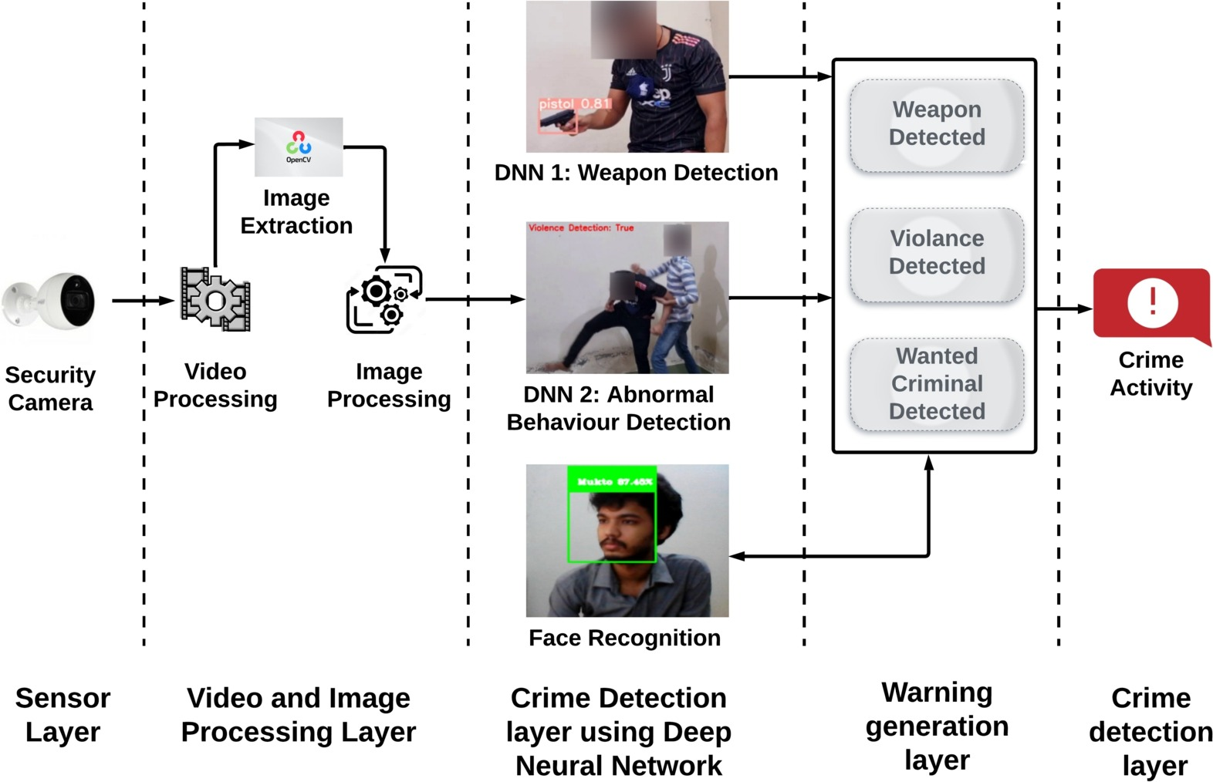
System Framework

Slide 7
System Architecture Development
Convolutional Neural Networks (CNNs) are used to detect suspicious objects and abnormal behavior in surveillance footage.
Pre-trained models YOLO (You Only Look Once) is used to identify objects of interest efficiently.
Object detection algorithms can be trained to detect specific objects related to criminal activities, such as weapons.

Slide 8
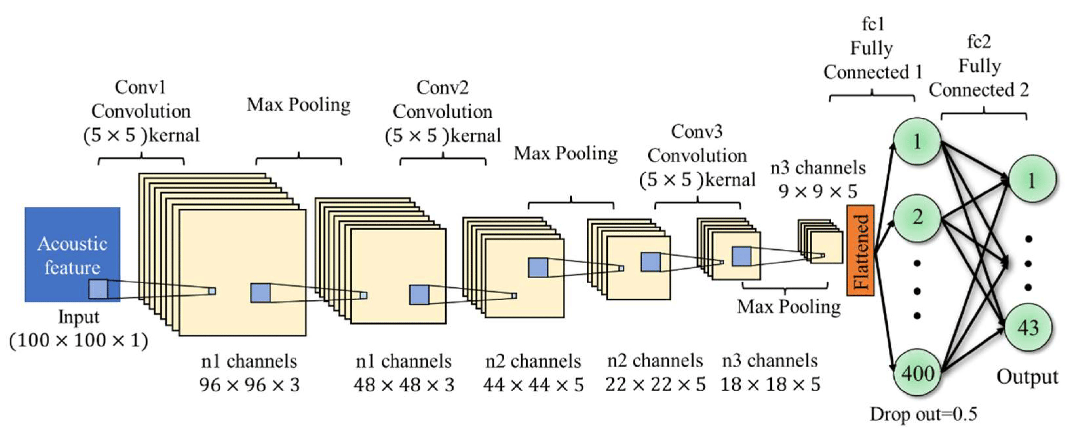
Convolutional Neural Network

Slide 9
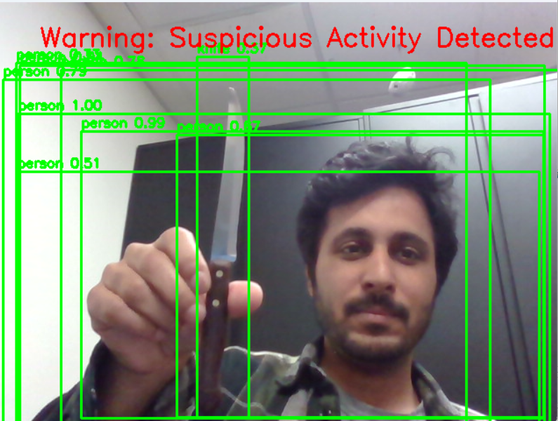
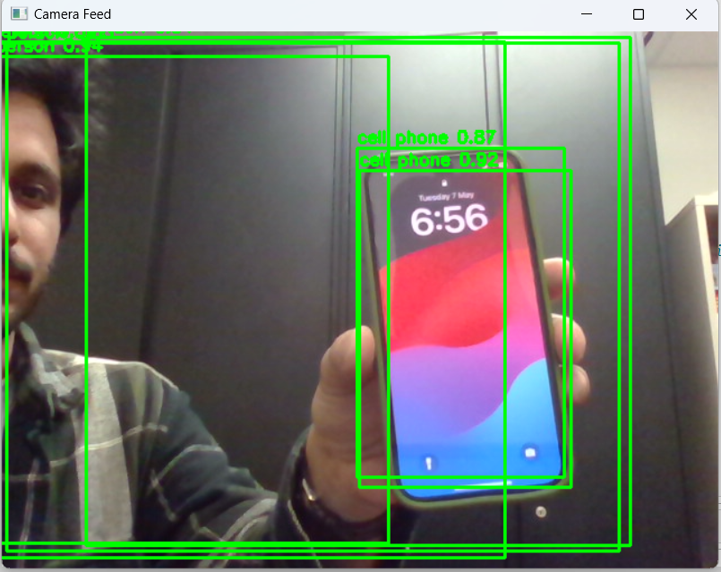
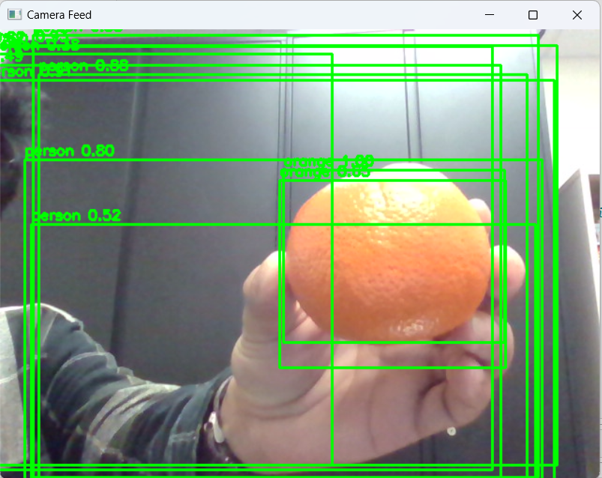
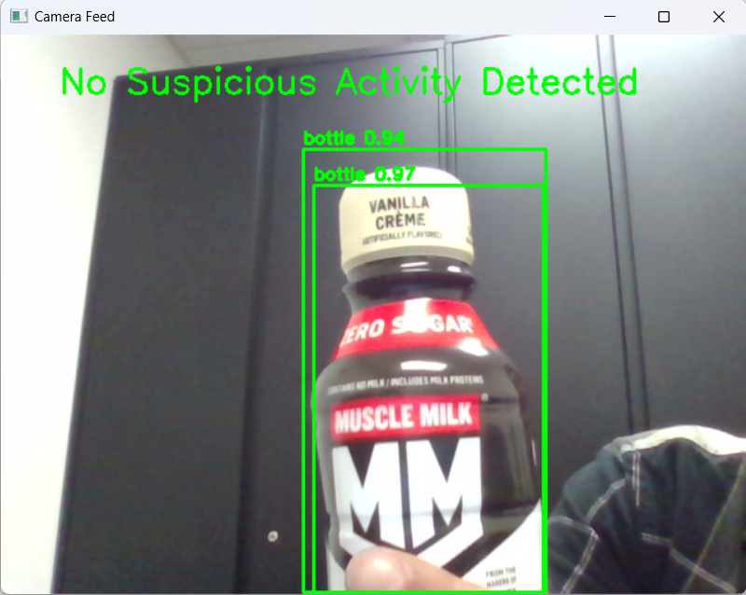
Result
Confidence: 0.37
Confidence: 0.87/0.92
Confidence: 0.85/1.00
Confidence: 0.94/0.97

Slide 10
Scope of Improvement
1
Feature Engineer:
Libraries like Pandas, Geopy can be utilized to track the time and location of incident.
Geospatial Analysis:
To identify the area with high criminal activities, K-means machine learning algorithm can be used supported by PySAL library.
Ensemble Learning:
To combine the strength different machine learning algorithm in the system can provide more accurate and reliable result, and for this we can leverage Gradient Boost Machines algorithm.
2
3

Slide 11
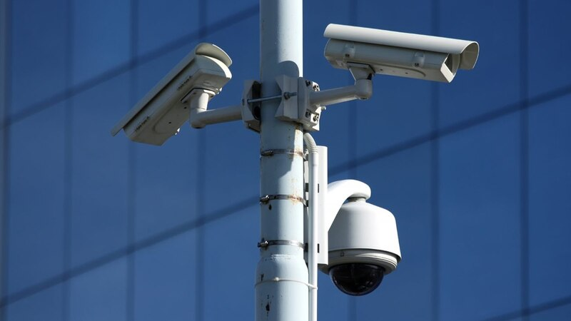
Thank you

